Slide 1
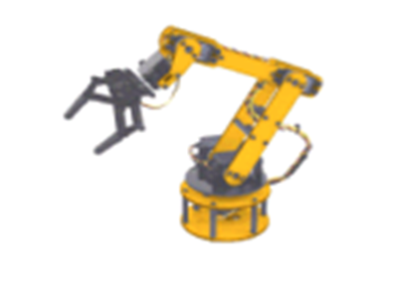
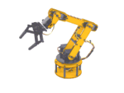
Applied Software Factories
Streamlining Software Development by Exploiting Commonality
Javier Lozano
Iowa .NET User Group
Session # 102

Slide 2


this.ToSlide();
javier@lozanotek.com
http://blog.lozanotek.com
ASP.NET MVP
Leader for Iowa .NET User Group

Slide 3
Info & Goals
Goals
Share the knowledge
Get you excited about playing with this stuff
Info
WOW Factor: LOW
Ah, Ha! Factor: HIGH
I will be doing a series of webcasts on the software factories on codetolive.net, so stay tuned!!

Slide 4
Agenda
Why?
Software Development as an Industry
What?
A Software Factory is...
Domain Specific Languages (DSL)
How?
Software Factories from p&p
Web Client Software Factory (WCSF)
Web Service Software Factory (WSSF)
Microsoft Codename “Acropolis”

Slide 5
Quick Survey…
How many of you use the following?
Code Generation
Build Servers
Unit/Automatic Tests
Graphical Design Tools
Object-Relational Mapping (ORM) Tools
Custom Visual Studio Templates

Slide 6

Agenda: Why?
Software Development Industry
Critical Innovations

Slide 7
Software Development as an Industry
Monolithic construction
“Code Addiction”
“Not Invented Here” (NIH) syndrome
“Roll Your Own Protocol” (RYOP)
One-off development
No families of products
Lack of “big picture” thinking/view
Notes:
Talk about how as software producers always want to build vs. buy. In particular, how we at times lack to see the big picture of “commoditizing” our products/services. Use Google as an example, Gmail, Google Calendar and Maps.
Explain how currently tools are too specific to the “core of programming” – syntax checking, highlighting and basic add-ins. Wouldn’t it be nice that these tools could also know about our domain? (ie. Insurance, Banking, Retailer Services, etc.)
We’re always looking for the silver bullet to aid in our business-to-IT translation.

Slide 8
Software Development as an Industry
Tools are too generic
3GL languages not easily map to “real world”
Too much freedom
Process immaturity
Too formal or too agile
Notes:
Talk about how as software producers always want to build vs. buy. In particular, how we at times lack to see the big picture of “commoditizing” our products/services. Use Google as an example, Gmail, Google Calendar and Maps.
Explain how currently tools are too specific to the “core of programming” – syntax checking, highlighting and basic add-ins. Wouldn’t it be nice that these tools could also know about our domain? (ie. Insurance, Banking, Retailer Services, etc.)
We’re always looking for the silver bullet to aid in our business-to-IT translation.

Slide 9
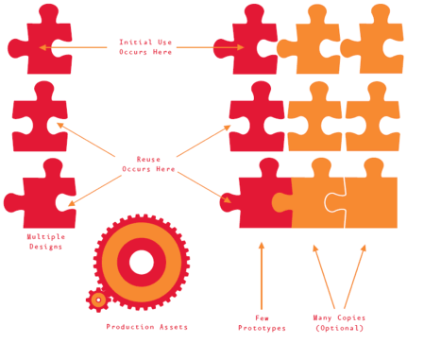
Critical Innovations
Systematic reuse
Software product families
Prototype investment
Model-driven development
Raise the level of abstraction for developers
Domain specific languages
Process frameworks
Preserve agility while scaling up
Active guidance, software agents
Notes:
Explain that as we shift the paradigms of components/objects, that complexity will increase. So we REALLY need to deal with that…how, by adding another layer/tool to aid in the process.

Slide 10
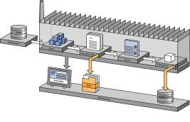
Agenda: What?
A Software Factory is…
Software Factory Schemas
Software Factory Templates
Domain Specific Languages (DSL)
What is a language?
What is a domain?

Slide 11
A Software Factory is …
“like a restaurant…”
A development environment for a product family
Based on “Economies of Scope” theory
Reuse similar parts, designs
Don’t build from scratch
80-20
Notes:
ARCast.NET – Why The Software Industry Does Not Run Restaurants
http://tinyurl.com/3dd6zs
When people hear the word, “factory”, they think dumb repetitive tasks (something robots would do). Instead they should see the fine orchestration between process and guidance for building a product (car, washing machine, software, etc.)
Economies of scope occur where it is cheaper to produce a wider range of products rather than specialize in just a handful of products.
In automobile manufacturing, for example, multiple similar but distinct automobile designs are often developed by composing existing designs for subcomponents, such as the chassis, body, interior, and drive train, and variants or models are often created by varying features, such as engine and trim level, in existing designs. In other words, the same practices, processes, tools, and materials are used to design and prototype multiple similar but distinct products.

Slide 12
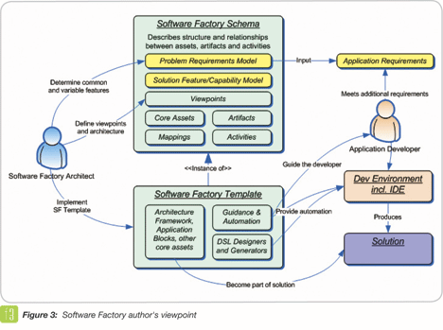
A Software Factory is …
Made up of two main parts:
Software Factory Schema
Software Factory Template
Notes:
ARCast.NET – Why The Software Industry Does Not Run Restaurants
http://tinyurl.com/3dd6zs
When people hear the word, “factory”, they think dumb repetitive tasks (something robots would do). Instead they should see the fine orchestration between process and guidance for building a product (car, washing machine, software, etc.)
Economies of scope occur where it is cheaper to produce a wider range of products rather than specialize in just a handful of products.

Slide 13
Software Factory Schemas
“It’s like a recipe...”
List of ingredients
Produce family members
Defines a set of viewpoints
Concerns
Requirements
Domain specific
Conceptual to physical
Notes:
The columns define concerns, while the rows define levels of abstraction. Each cell defines a perspective or viewpoint from which we can build some aspect of the software.
Once the grid has been defined, we can populate it with views that comprise the development artifacts for a specific software product.

Slide 14

Software Factory Templates
“It’s like the ingredients for your recipe…”
Collection of assets
Implementation of schema
Installable content
Frameworks
Patterns
Components, source code
Samples, Documentations
Tools

Slide 15
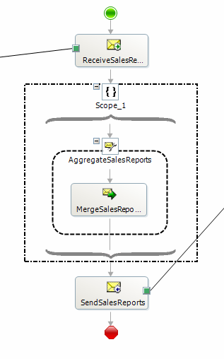
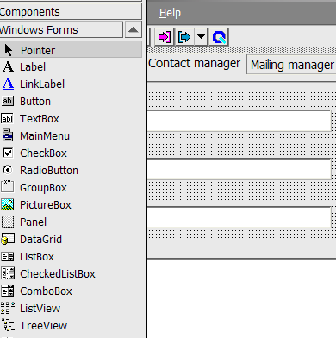
DSL: What is a language?
A model that can be processed by a tool
Not only documentation
Code generation & Configuration
Linguistic wrapper
Visualizing the intent
Textual/Graphical
Forms Designer?
SQL, Orchestration
XML based

Slide 16
DSL: What are “domains”?
Presentation domain
Form editor
Logic Domain
BizTalk Orchestration Editor
Windows Workflow Editor
Data domain
DTS Editor, NHibernate

Slide 17
Questions?
Come, on…don’t be afraid. ;-)

Slide 18

Agenda: How?
Software Factories from p&p
Web Client Software Factory (WCSF)
Web Service Software Factory (WSSF)
Microsoft Codename “Acropolis”

Slide 19





Software Factories from p&p
Help you build a specific kind of application (smart client, service, etc)
Incorporate a variety of guidance content types and form factors
Guidance, not production products.
App Block Library
Guides
App Blocks
Patterns
Help
Code Samples

Slide 20
Required Software
Guidance Automation Extensions (GAX)
Guidance Automation Toolkit (GAT)
EnterpriseLibrary (latest)
Visual Studio 2005 SP1
VS2005 Extensions for Windows Workflow Foundation
VS2005 Extensions for .NET Framework 3.0 (WCF & WPF), November 2006 CTP

Slide 21
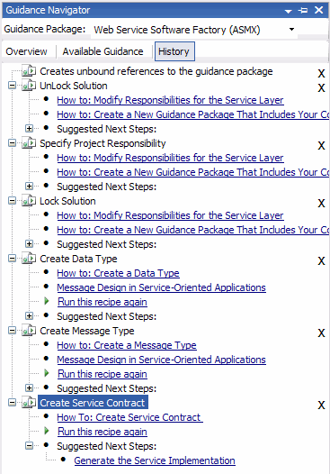
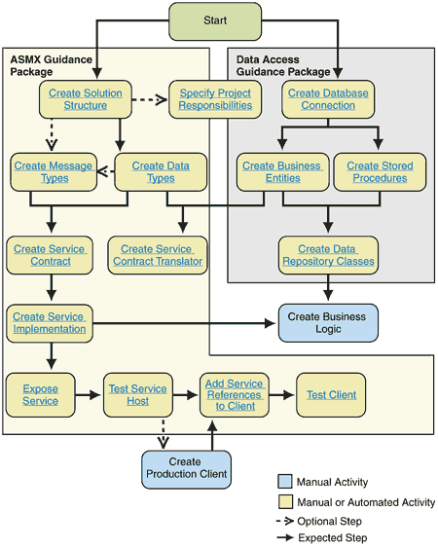
Software Factories from p&p
Architect
Developer
Visual Studio

Slide 22
Component Overview
WCSF: Demo

Slide 23
WCSF: What does it address?
Modularity
Separating concerns: Shell, business logic, infrastructure
Development by separate teams
Deploy without affecting other teams work
Look and feel consistent across teams
Avoid duplication of common services such as security and logging
UX
Navigation
Role Based UI
Security
Securing Data
Authentication / Authorization
Data Input Validation

Slide 24
WCSF: What does it provide?
Guidance and tools for Web Client development
Declarative navigation and page flow
Consistent and Profile based UI
Simplified Deployment Model for loosely coupled modules
Visual Studio 2005 Integration
Customizable and extensible

Slide 25
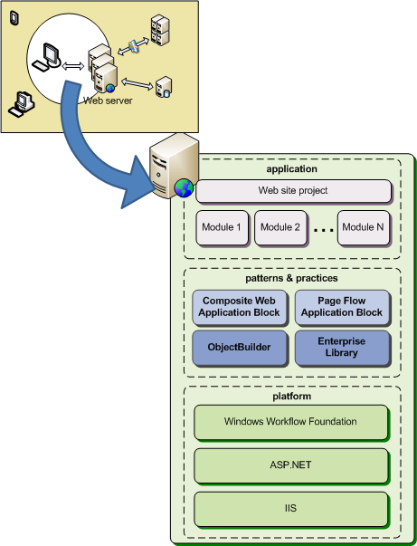
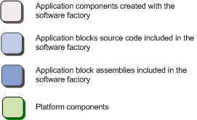
WCSF: Components
Composite Web Application Block
Page Flow Application Block
ObjectBuilder
Enterprise Library

Slide 26
WCSF: Composite Web Application Block
Provides the plumbing for a composite web application
Utilizes ObjectBuilder dependency injection framework
Shares some concepts with Composite UI App Block
Introduces modules as separate units of deployment

Slide 27


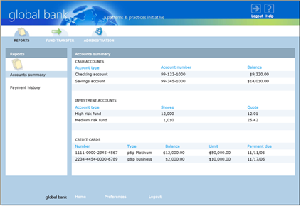



WCSF: Architecture
Shell using Master Page, AccessDenied.htm
Visual Icons
Root Composition Container
View
Site Map Node
View
Site Map Node
Comp Container
Shared Services
Authorization Service
Service
Service
Module
Module
Catalog

Slide 28
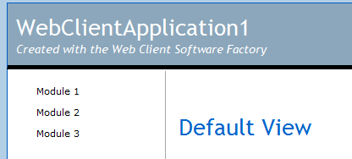
Site map navigation
Modules load dynamically
They need to publish what they can do
SiteMapBuilder is the key
Uses ASP.NET’s SiteMap support
Can be role based
Shell
SiteMapNodeInfo moduleNode =
new SiteMapNodeInfo("Module1", "~/Module1/Default.aspx", "Module1");
siteMapBuilderService.AddNode(moduleNode);
// Specify the parent node
siteMapBuilderService.AddNode(moduleNode, parentNode);
// Specify the preferred display order
siteMapBuilderService.AddNode(moduleNode, 100);
// Specify the authorization rule
siteMapBuilderService.AddNode(moduleNode, “AllowViewModule1”);
Site Map Navigation Service
Site Map Node
Module1
Site Map Node
Module2
Site Map Node
Module3

Slide 29
WCSF: Page Flow Application Block
Tackles the “Navigation” Technical Challenge
Allows Page design and Page navigation to be separated
Allows visualization of the navigation path

Slide 30
WCSF: Page Flow Application Block
Supports serializable state, flows can be suspended
Supports Abortable and non-abortable flows
Extensible:
In-the-box solution utilizes Windows Workflow Foundation
Additional navigation implementations can be created

Slide 31
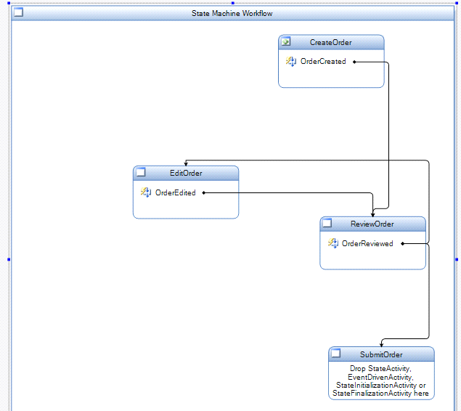

WCSF: Page Flow Application Block
CreateOrder.aspx
ReviewOrder.aspx
User
Browser
EditOrder.aspx
Submit Order.aspx

Slide 32
WCSF: Model View Presenter Pattern
A UI pattern for that separates the UI-Centric business logic from the UI itself.
Allows unit testing of UI logic
Makes the UI less brittle
Can be used in several ways:
With a Model
With an Application Controller
Model
View
Presenter

Slide 33
WCSF: Services
A service is name for an object that provides functionality to other components (the components can be in the same module or in another module) in a loosely coupled way.
Characteristics
I don’t know or care who created it
I don’t know or care what the implementation is
I am not responsible for disposing it.
ILogging
Service
Customer
IAccounts
Service

Slide 34
WCSF: Dependency Injection
Pattern that allows abstractly defining object dependencies and passing in concrete implementations at runtime.
Benefits:
Allows you to decouple your classes from logic for retrieving dependencies.
Dependencies can be replaced or updated requiring minimal or no changes to your classes’ source code.
Allows writing classes that depend on services whose concrete implementation is not known at compile time.
Facilitates testing your classes in isolation using test doubles.
Work Item
ILogging
Service
Locates
Customer
Object
Builder
Injects

Slide 35
Service and Data contracts in WCF
WSSF: Demo

Slide 36
WSSF: What does it address?
Message and service interface design
WSDL-first service design (also XSD)
Exception shielding and exception handling
Applying message-level security
Semantic and security code analysis

Slide 37
WSSF: What does it address?
Planning for the migration to WCF
Message validation (service behavior)
Message translation to business entities
Designing business entities in the domain model
Designing, building, and invoking the data access layer

Slide 38
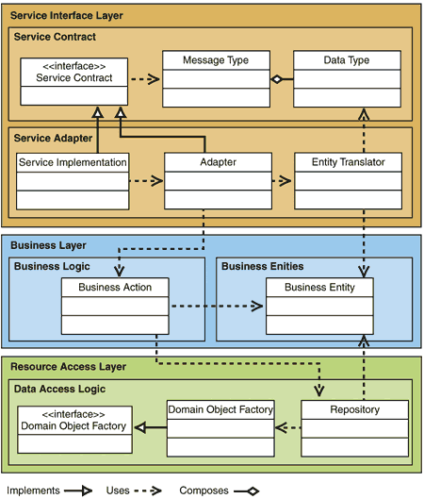
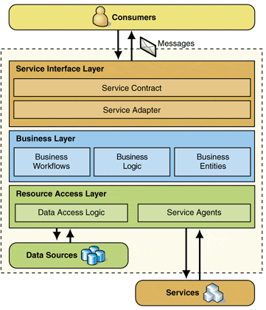
WSSF: What does it provide?
Designing messages and service interfaces
Applying exception shielding and handling
Designing business entities in the domain model
Translating messages to and from business entities
Designing, building, and invoking the data access layer
Planning for the migration to WCF

Slide 39
Acropolis: What is it?
Components and tools that make it easier for developers to build and manage modular, business focused, client .NET applications.
Acropolis is part of the “.NET Client Futures” wave of releases, our preview of upcoming technologies for Windows client development.

Slide 40
Acropolis: What is it?
With Acropolis you will be able to:
Quickly create WPF enabled user experiences for your client applications.
Build client applications from reusable, connectable, modules that allow you to easily create complex, business-focused applications in less time.
Integrate and host your modules in applications such as Microsoft Office, or quickly build stand-alone client interfaces.

Slide 41
Acropolis: What is it?
Change the look and feel of your application quickly using built-in themes, or custom designs using XAML.
Add features such as workflow navigation and user-specific views with minimal coding.
Manage, update, and deploy your application modules quickly and easily.

Slide 42
RSSEagle Sample
Acropolis: Demo

Slide 43
Resources
Software Factories: Assembling Applications with Patterns, Models, Frameworks, and Tools
http://tinyurl.com/2o9qum
DSL Tools for Visual Studio
http://tinyurl.com/35jecs
Web Client Software Factory on CodePlex
http://www.codeplex.com/websf
Design Patterns: Model View Presenter
http://tinyurl.com/kcs9m

Slide 44
Resources
Design Patterns: Dependency Injection
http://tinyurl.com/fhdf3
Windows Workflow Foundation
http://wf.netfx3.com
Service Software Factory on CodePlex
http://www.codeplex.com/servicefactory
Windows Communication Foundation
http://wcf.netfx3.com
Microsoft Codename “Acropolis”
http://windowsclient.net/Acropolis/

Slide 45
Resources
Microsoft Codename “Acropolis”
http://windowsclient.net/Acropolis/

Slide 46
Questions?
Come, on…don’t be afraid. ;-)

Slide 47
Thanks for coming!
Javier Lozano
javier@lozanotek.com
http://blog.lozanotek.com
Please complete the feedback for this session.
Session #: 102
Enjoy the remainder of HDC and your stay in Omaha!

